Slide 1
The Cycle – Responsive Web Design
Brian Thompson

Slide 2

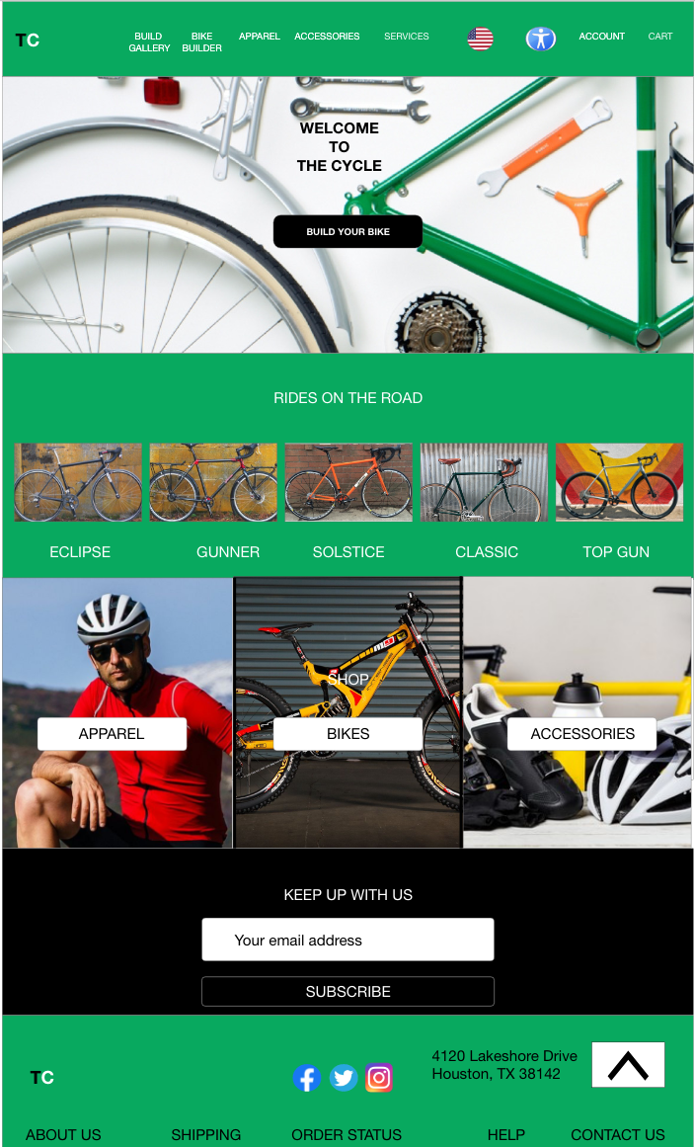
Project overview
The product:
The Cycle is a responsive website that provides an opportunity for those to build a custom bicycle from start to finish. The typical user is between 28-50 years old, and most users are early to mid level professionals. The Cycle’s goal is to make designing a custom bike easy, fun, and fast for all types of users.
Project duration:
December 2021 – January 2022

Slide 3
Project overview
The problem:
Available custom bike websites were not easy to navigate, cluttered designs, and confusing checkout process.
The goal:
Design The Cycle website to have a user friendly and clear navigation to customize a bike and offer a fast and effective checkout process.

Slide 4
Project overview
My role:
UX designer and researcher from conception to completion
Responsibilities:
Conduct interviews, paper and digital wireframing, low and high fidelity prototyping, conducting usability studies, accounting for accessibility, iterating on designs and responsive design

Slide 5
User research
Personas
Problem statements
User journey maps
Understanding
the user

Slide 6
User research: summary
I conducted user interviews in order to create empathy maps to discover who the appropriate users would be, their pain points, and needs. I discovered that my target users take building their custom bikes seriously because they like the attention to detail they can put in their bikes; some users even compete professionally. Users ultimately want this process to be seamless as they have experienced quite a bit of frustrations with navigation on websites that offer this service.

Slide 7
User research: pain points
1
2
3
4
Navigation
Interaction
Experience
Pain point
Write one to two sentences reflecting on the pain point listed above and how it will guide designs moving forward.
Write one to two sentences reflecting on the pain point listed above and how it will guide designs moving forward.
Write one to two sentences reflecting on the pain point listed above and how it will guide designs moving forward.
Write one to two sentences reflecting on the pain point listed above and how it will guide designs moving forward.

Slide 8
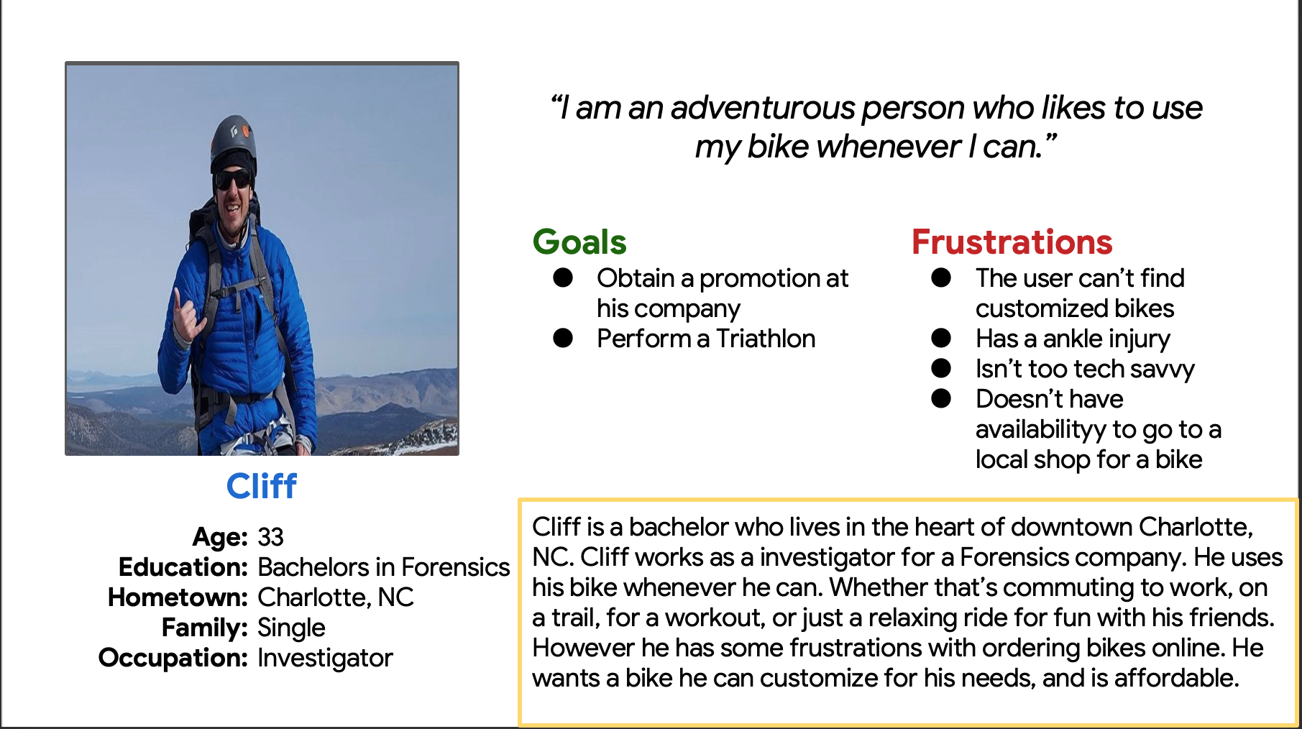
Persona: Cliff
Problem statement:
Cliff is a full time worker and avid cyclist who needs a user friendly website with a great selection of bikes that can be customized because he wants to be able to have the best bike for his needs.

Slide 9
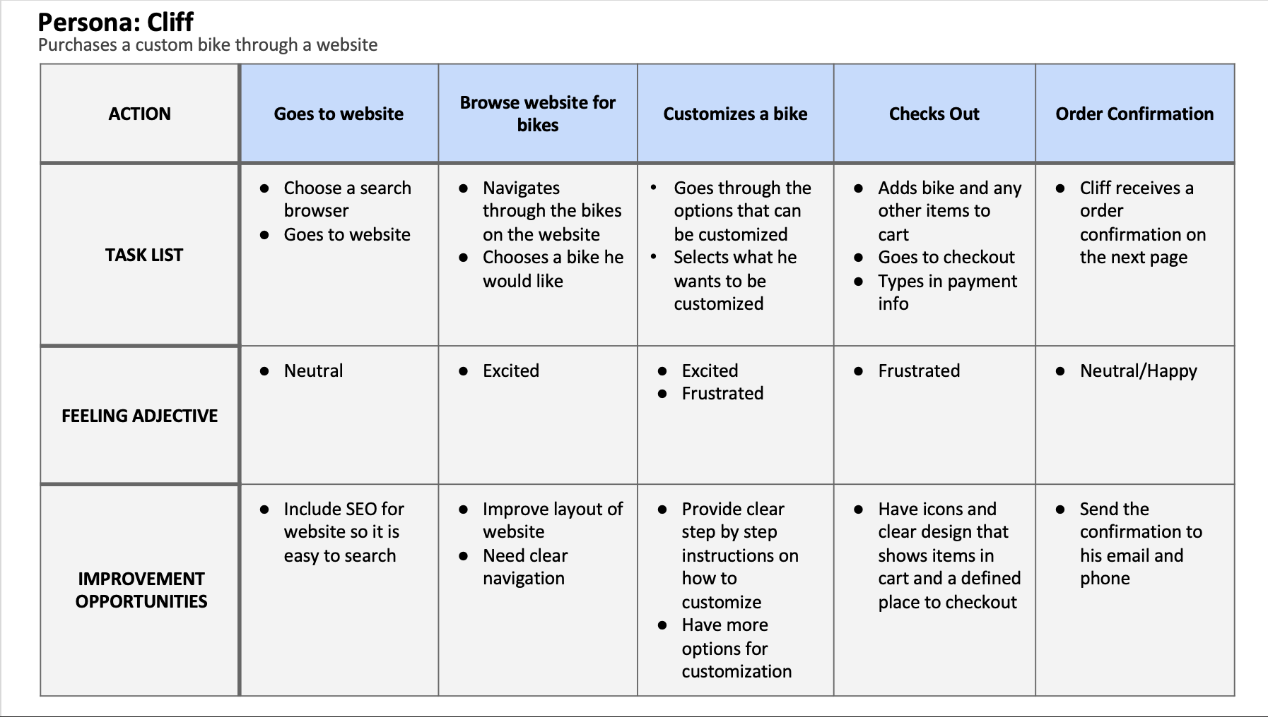
User journey map
The goal of the user journey map was to help us hone in on the users specific pain points through their typical experience through ordering a customized bike online.
Image of user journey map

Slide 10
Sitemap
Paper wireframes
Digital wireframes
Low-fidelity prototype
Usability studies
Starting
the design

Slide 11
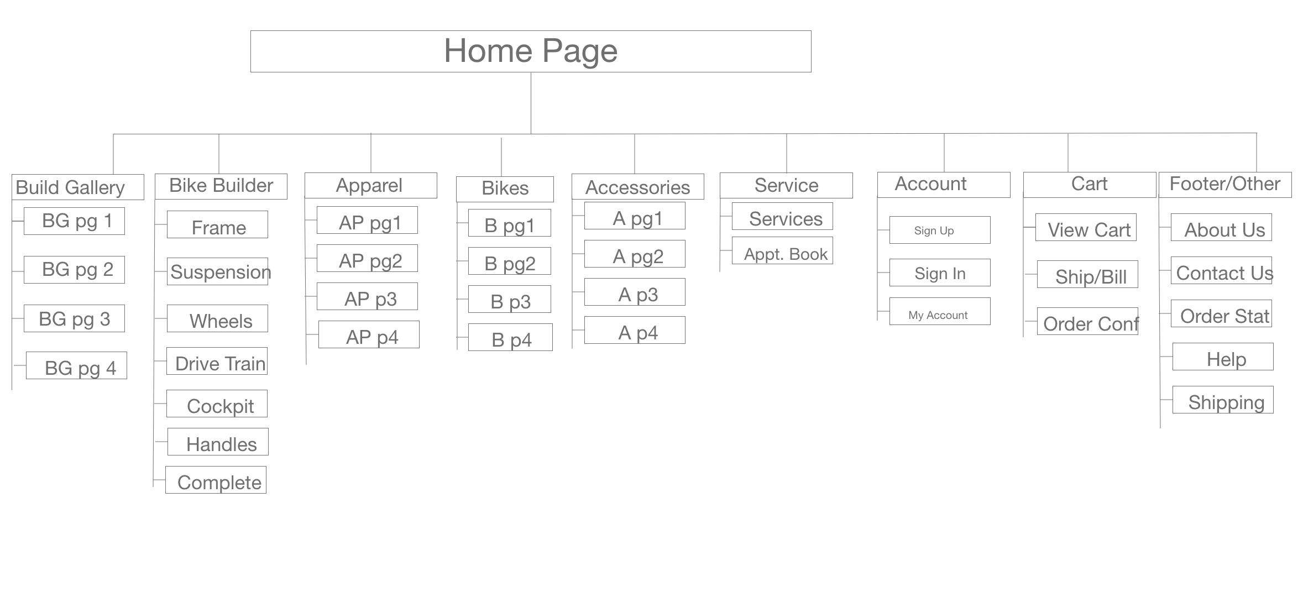
Sitemap
The sitemap outlines the specific tabs the user will see on the website. The bike builder portion shows what steps the user will take to build their bike.
Image of sitemap/IA

Slide 12
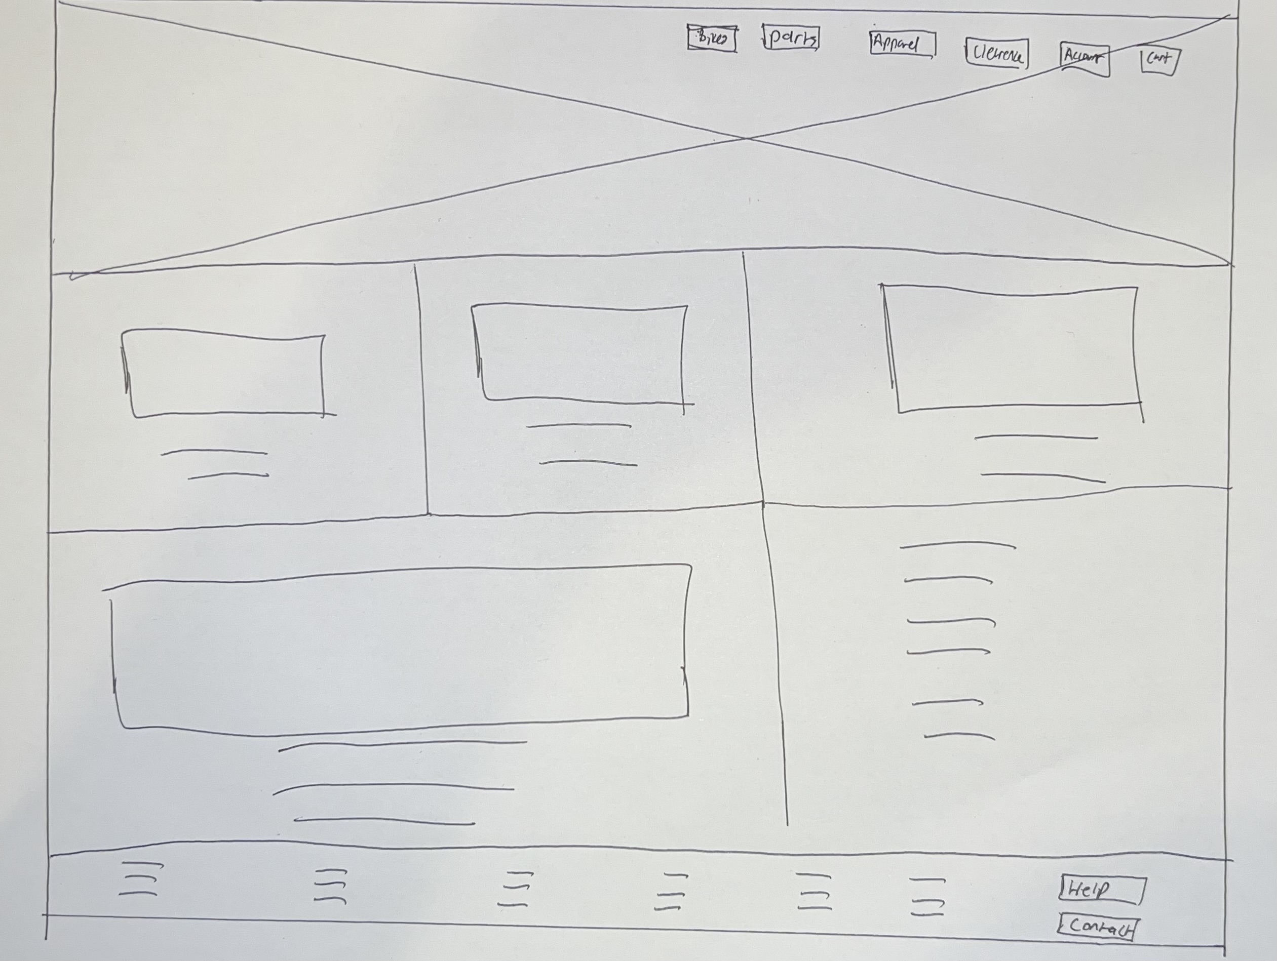
Paper wireframes
The goal of the paper wireframe was to iterate on the overall design of the homepage. A tiered layer cake layout was used for the homepage to best display the information.
Image of paper wireframes

Slide 13
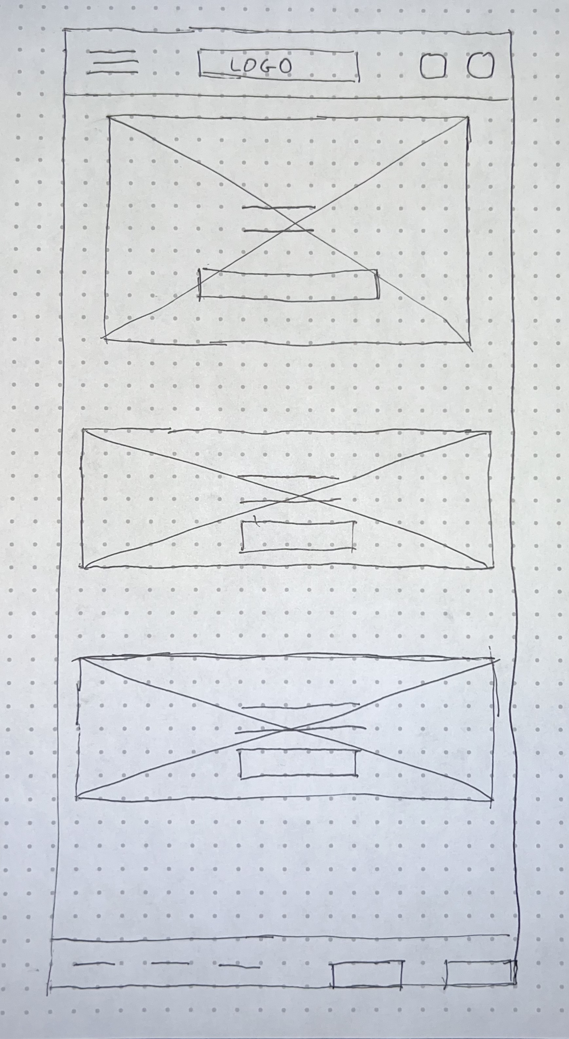
Paper wireframe
screen size variation(s)
This is a mobile variation of the original paper frame for the website. The mobile version uses a one column layout, and the navigation features a hamburger menu that will flyout when the user clicks on it. Logo has been moved to the middle of the header.
Image of paper wireframe screen size variation(s)

Slide 14
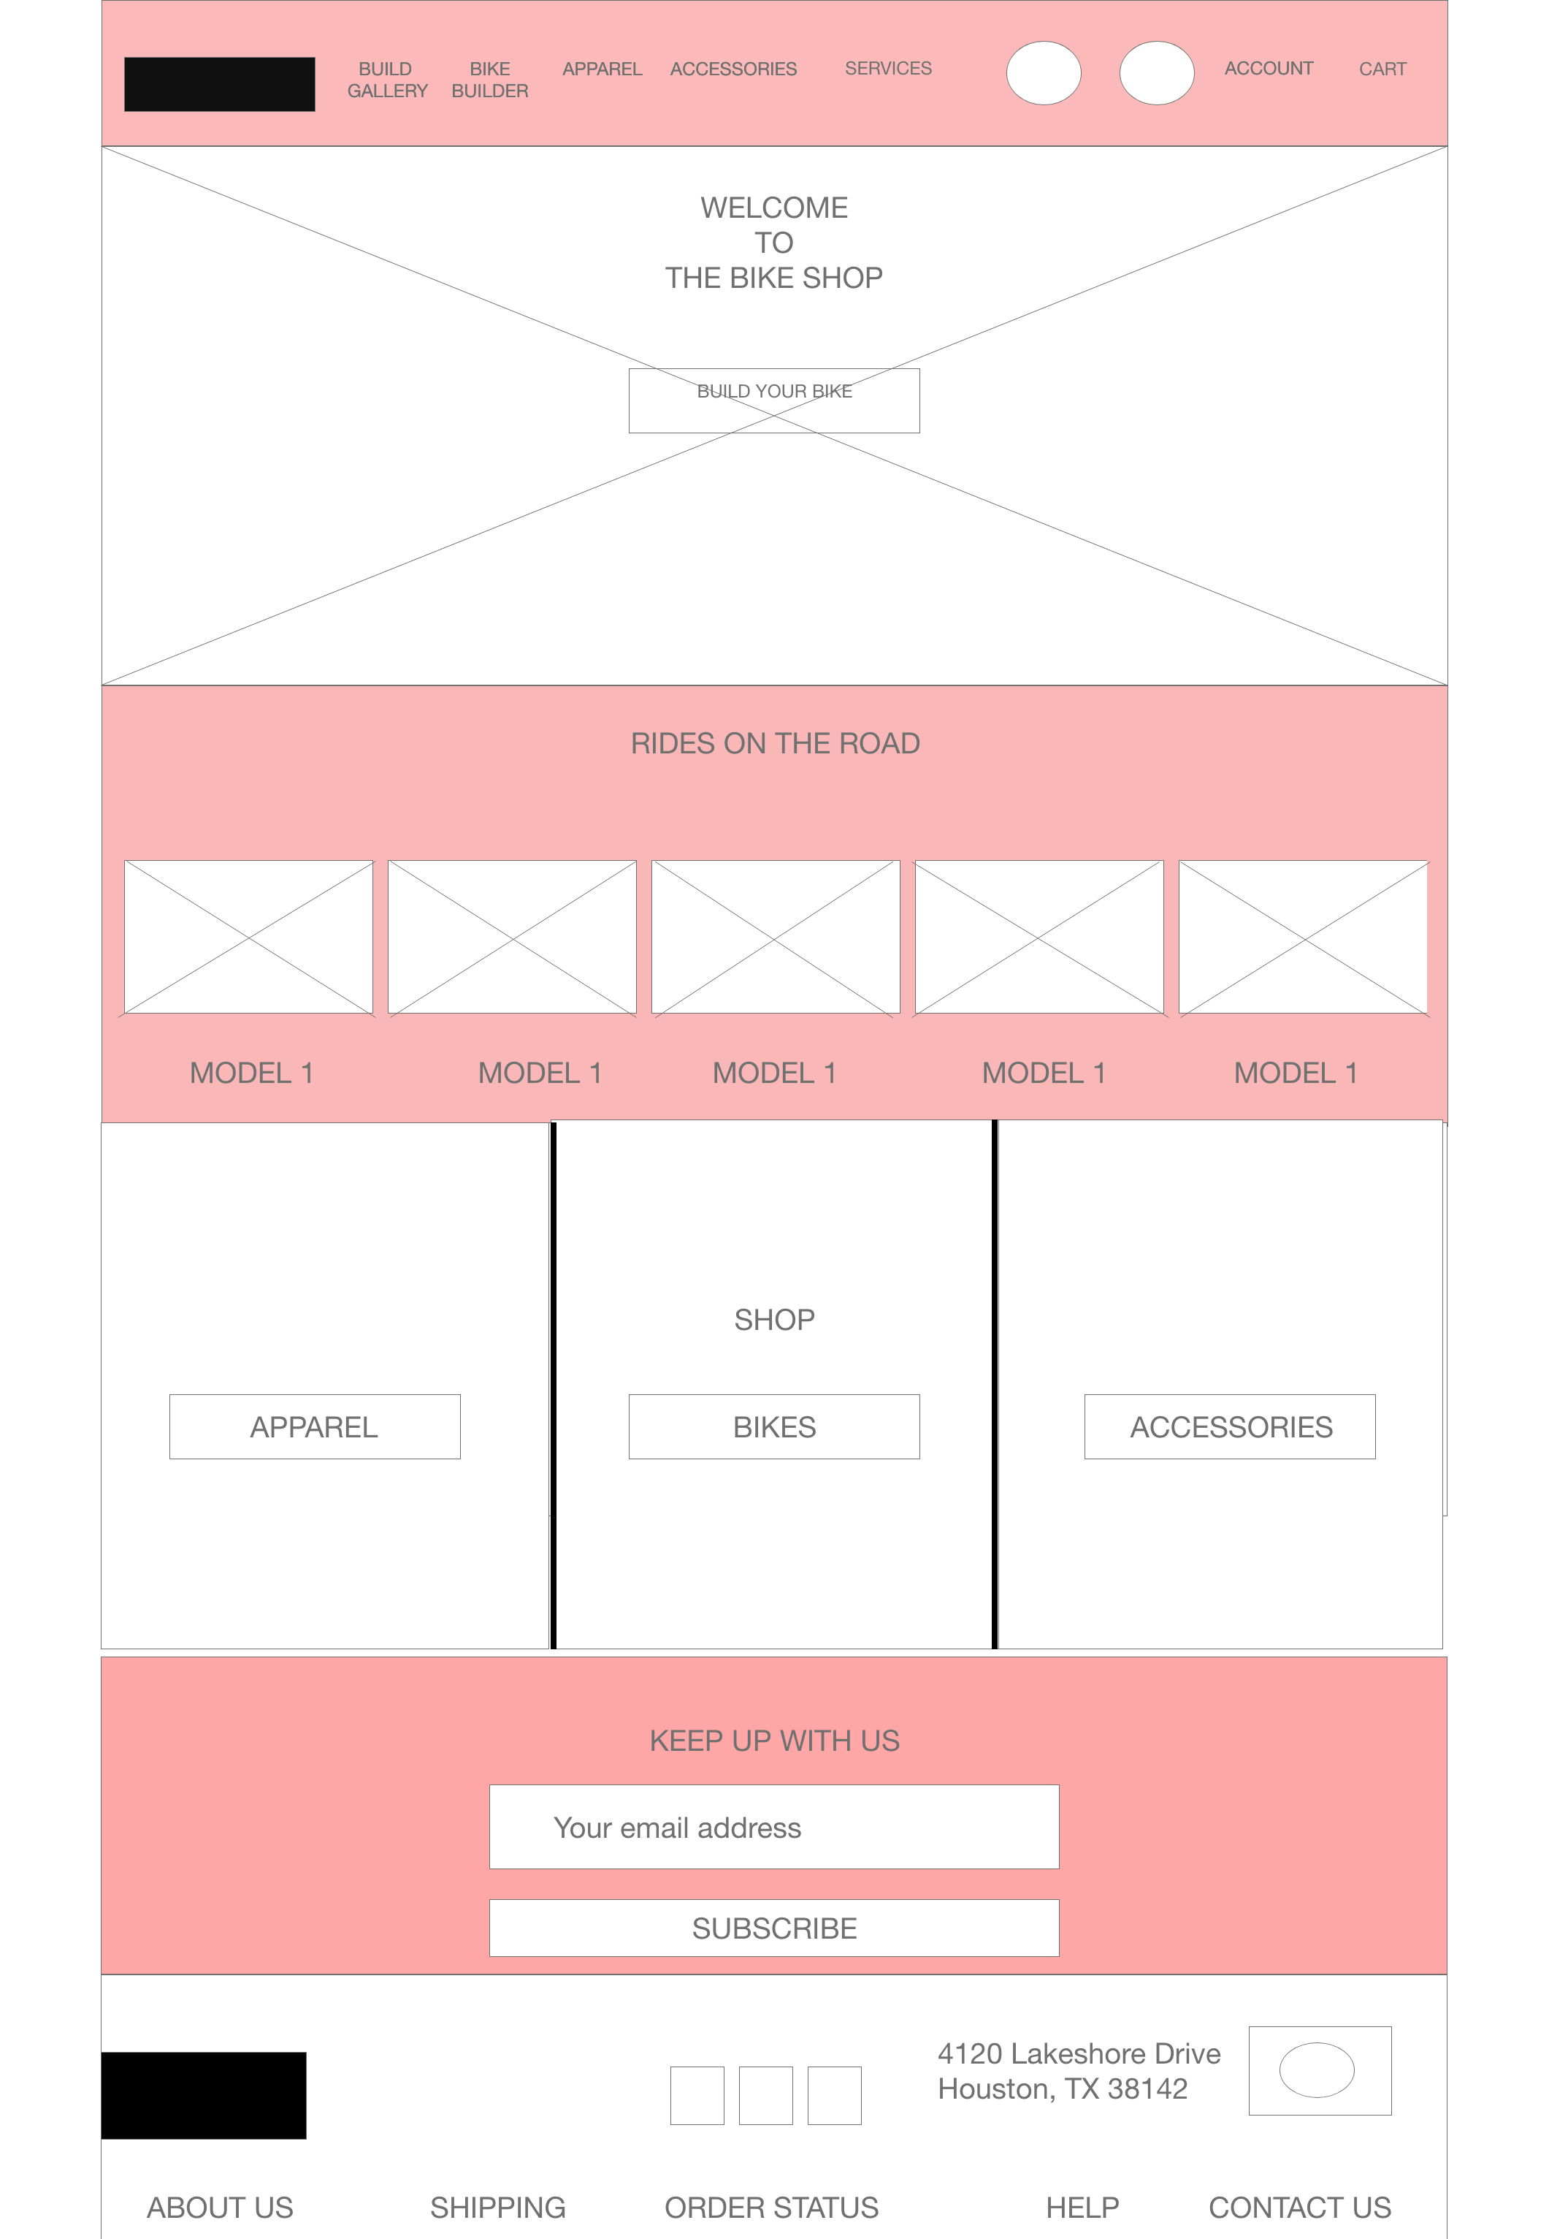
Digital wireframes
Users can access the bike builder feature here
This is the homepage of the website. The goal of the website was to present the user with the option to build their bike as soon as they arrive at the page, and see what type of custom bikes have been made by others.
Insert first wireframe example that demonstrates design thinking aligned with user research
Bikes that have been customized by others.
Users can go to these to buy other things within the website
Footer

Slide 15
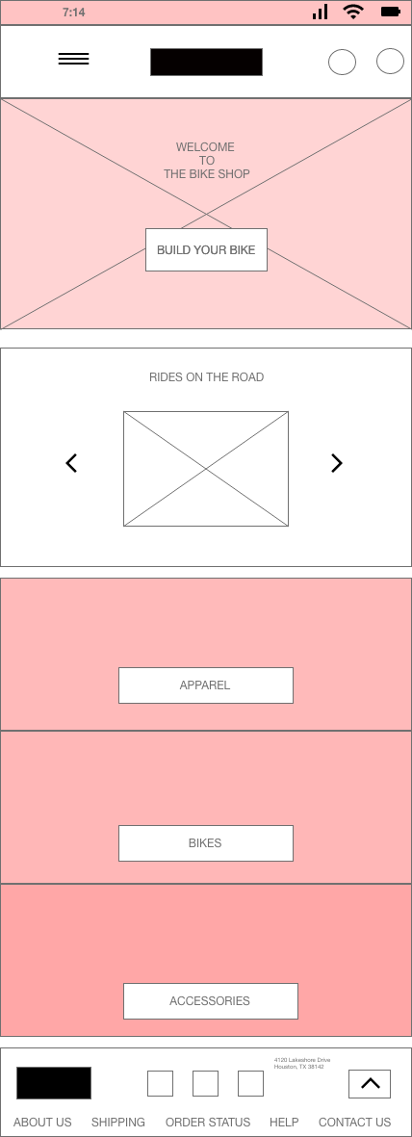
Digital wireframe
screen size variation(s)
This digital wireframe features a hamburger navigation, carousel for users to see the latest customized bikes users have made, and the build your bike button on the hero image.
A one column layout was used to achieve a uniform look.
A scroll up arrow at the bottom right will allow the user to scroll back up to the top of the page.

Slide 16
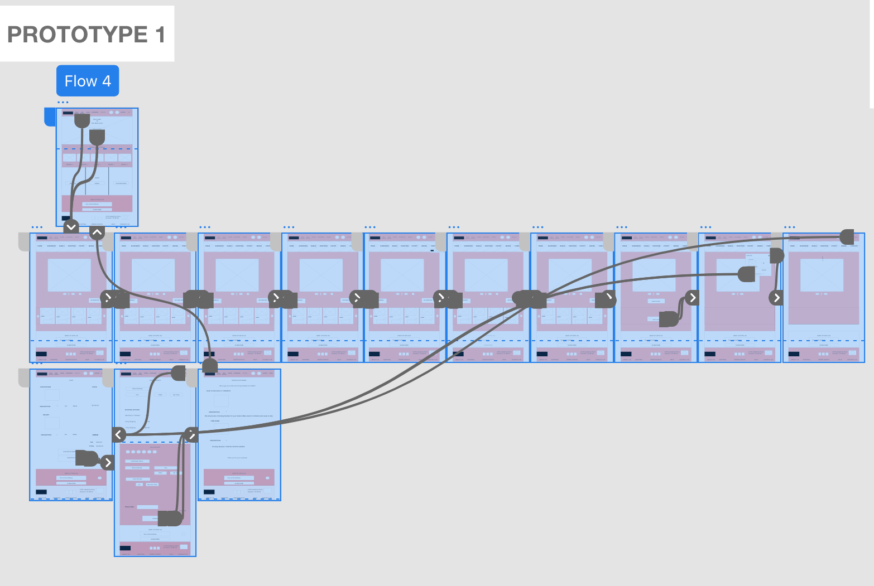
Low-fidelity prototype
Link to Low-fidelity prototype here

Slide 17
Usability study: parameters
Study type:
Unmoderated usability study
Location:
United States, remote
Participants:
5 participants
Length:
20-30 minutes

Slide 18
Usability study: findings
1
2
3
Shipping Selection
Progress of Building Bike
Shipping Options
5 out of 5 users had difficulty selecting a shipping option when checking out.
3 out of 5 users had difficulties remembering which step they were on in the bike building process.
3 out of 5 users where dissatisfied when they couldn’t have items shipped together if ordering a custom bike with other items.

Slide 19
Refining
the design
Mockups
High-fidelity prototype
Accessibility

Slide 20
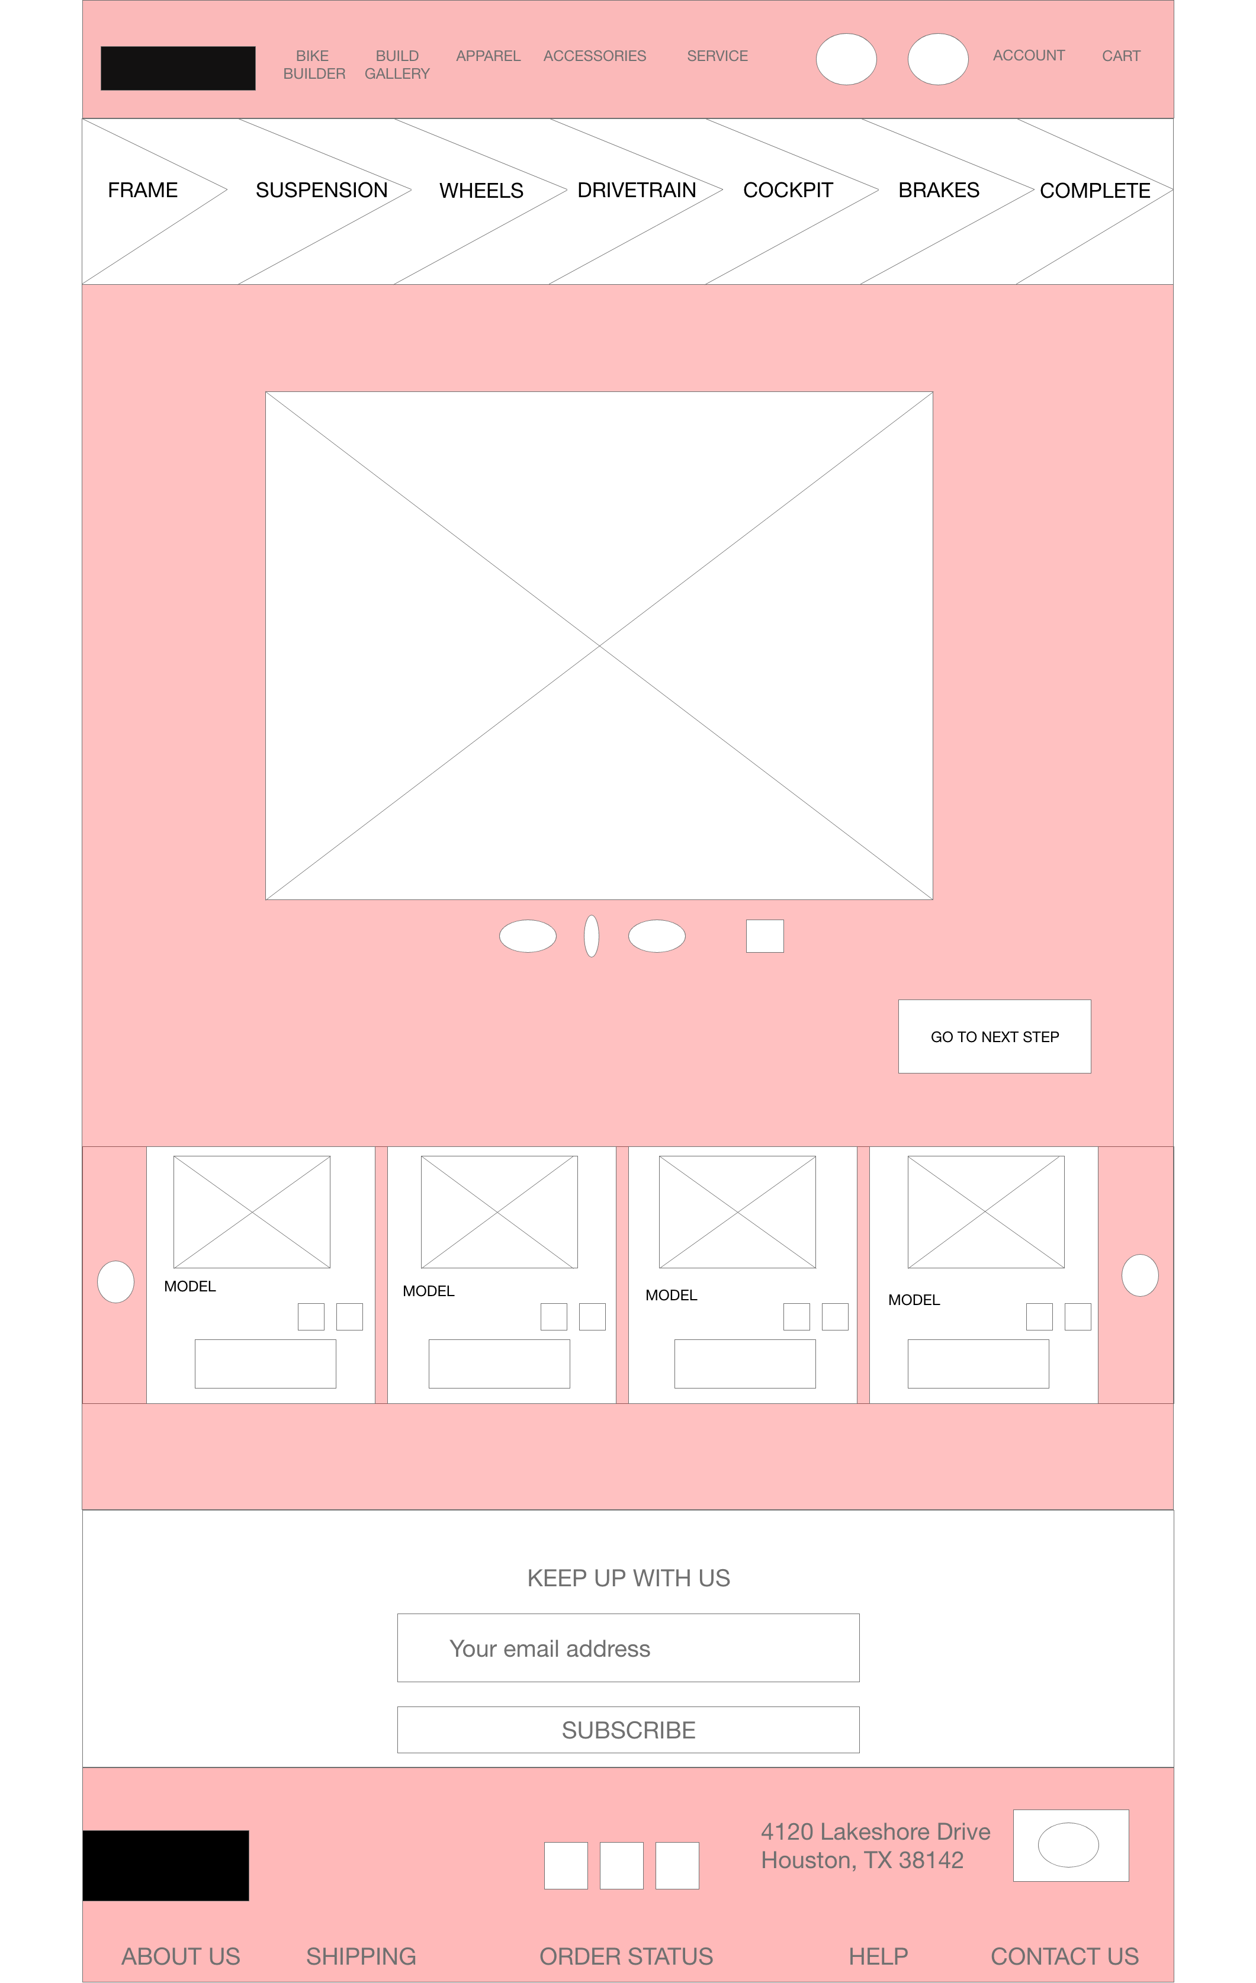
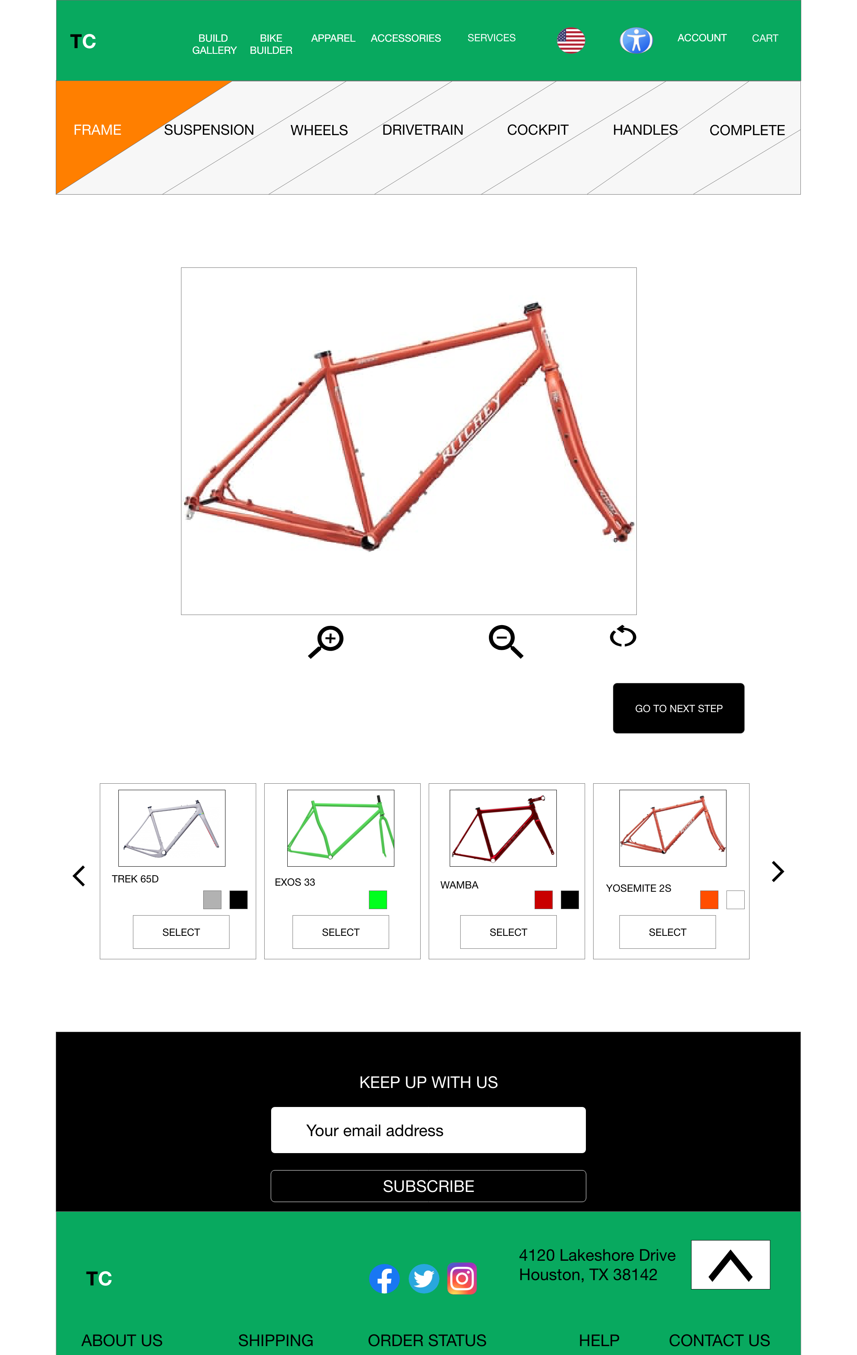
Mockups
The progress bar has been modified to show what step the user is on, as well as a previous and next button were added so the user can go back or forward when building their bike if modifications are needed.
Before usability study
After usability study
Mockup 1 before
Mockup 1 after

Slide 21
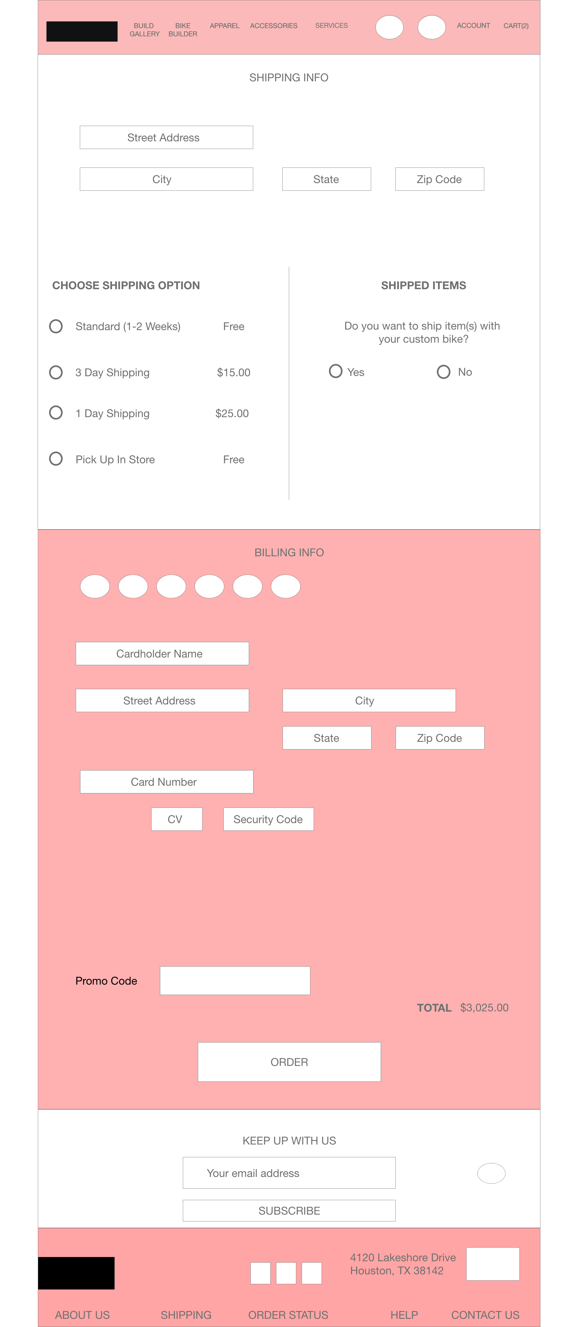
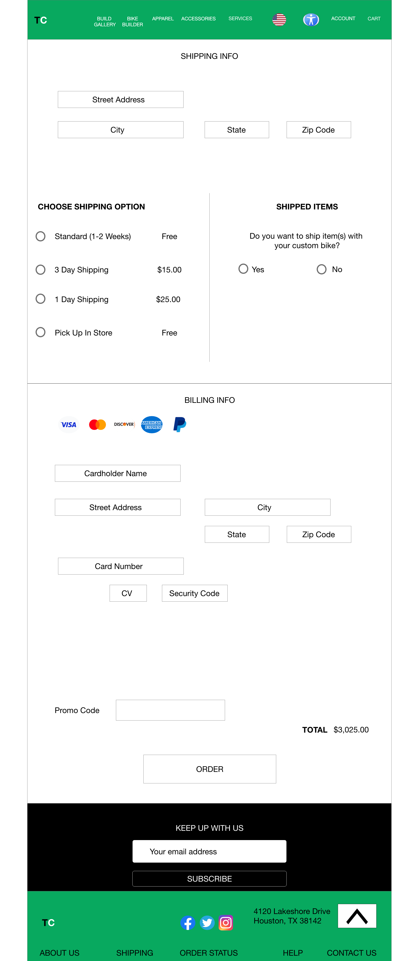
Mockups
User now has an option to select what option they would like to have for shipping, and if ordering a custom bike with other items, can select if they want to ship their bike with those items or not.
Before usability study
After usability study
Mockup 2 before
Mockup 2 after

Slide 22
Mockups: Original screen size
Main mockup screen for display
Main mockup screen for display
Main mockup screen for display
Main mockup screen for display

Slide 23
Mockups: Screen size variations
Main mockup screen for different screen size variations
Main mockup screen for different screen size variations
Main mockup screen for different screen size variations
Main mockup screen for different screen size variations

Slide 24
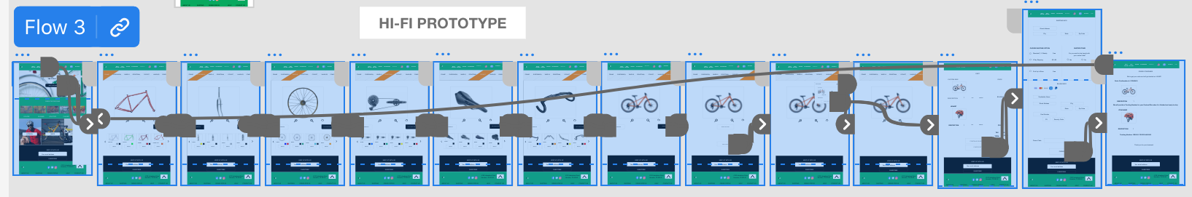
High-fidelity prototype
Link to High-Fidelity Prototype here
Screenshot of prototype with connections or prototype GIF

Slide 25
Accessibility considerations
1
2
3
A accessibility button is placed on the home screen for users that may need more assistance navigating the website.
On the homepage the user can select which language they would like to have the website in by clicking on the flag and selecting their language.
The overall typeface and contrast of colors are used in a way that are easy to read and navigate for any user.

Slide 26
Going forward
Takeaways
Next steps

Slide 27
Takeaways
Impact:
Overall after iterating after usability studies, participants seemed to be able to make and order their custom bike easily and were satisfied with the experience.
What I learned:
There are a lot of components that go into making a website that allows users to customize a product. However, I learned that sometimes less is more when creating these kinds of websites.

Slide 28
Next steps
1
2
3
Continue usability studies with participants
Iterate and revise mockups and high fidelity prototypes
Create code for the website

Slide 29
Insert a few sentences summarizing the next steps you would take with this project and why. Feel free to organize next steps in a bullet point list.
Let’s connect!
Thank you for checking out my work! If you would like to contact me, here is my information:
Email: brianthompson072@gmail.com

